Slide 1

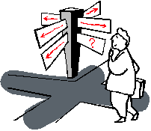

Slide 2
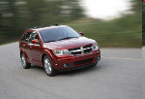




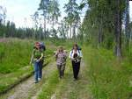
Travelling. The World of Opportunities.
We go by car and we go by train
We go by boat and we go by plane
We go by land and sea and air
We go, go, go from here to there

Slide 3
Repeat the words
еxchange programme - программа обмена
gap year - годовой перерыв
overseas - заграничный
be cultural aware - быть культурно осведомленным
culture shock - культурный шок

